Slide 1
Autogenerating fast packet-processing code using program synthesis
Xiangyu Gao, Taegyun Kim, Aatish Kishan Varma, Anirudh Sivaraman, Srinivas Narayana
Notes:
I am Xiangyu, I am a first-year Ph.D. student in New York University. Today, I will talk about autogenerating fast packet-processing code using program synthesis. This is joint work with Taegyun, Aatish, and Anirudh from NYU and Srinivas from Rutgers. .

Slide 2
Programmable network devices today
Lots of programmable network devices (e.g., switches, SmartNICs, NetFPGA)
Easy to get started with programming these devices
But hard to write fast packet-processing code that fits within resource constraints.
6.5 Tbits/s
40 – 100 Gbits/s
40 Gbits/s
Notes:
Recently, #### programmable network substrates have become quite widespread because they are more flexible than fixed-function devices.
These devices run at fairly high speeds today. #### For instance, switches runs at 6.5 Tbit/s in aggregate. #### SmartNICs run at line rates of #### 40-100 Gbit/s. #### The NetFPGA platform runs at line rates of #### 40 Gbit/s.
#### It is easy to get started with programming these devices. For example, you can read the tutorial or attend a workshop. #### However, developing fast packet-processing programs for these substrates that fit within resource constraints is hard.

Slide 3
Today’s approach to writing fast programs
Handcraft the fast programs
Requires familiarity with the underlying hardware architecture
Rely on the compiler.
Engineering a compiler takes a long time and large teams.
Difficult for new, niche, and evolving packet-processing hardware.
Cache and memory hierarchy for
SmartNICs and CPUs
Arithmetic logic unit (ALU)
for switches
Lookup Table for
FPGAs
Notes:
Today, there are two main approaches to writing fast programs but none of then is easy to implement.
#### First of all, we could handcraft the fast programs, #### but it requires manual optimization by experts who are familiar with each underlying hardware architecture. For example, #### they must be aware of the cache and memory hierarchy for CPUs and SmartNICs; #### Arithmetic logic units (or ALUs) present in programmable switches; #### and of lookup tables for an FPGA. For instance, Microsoft hired a dedicated team of hardware engineers to program its FPGA-based SmartNIC.
#### The second approach is to rely on the compiler itself and have the compiler do optimized code generation automatically. A compiler will definitely alleviate the difficulties of generating such fast code, but building a compiler itself is arduous because #### it requires significant engineering efforts, which is both time-consuming and money-consuming. For instance, Intel, AMD, and ARM have large compiler teams to develop compilers for each of their architectures.
#### In addition, because of the evolving nature of network hardware, and because it’s relatively more new and niche, it sometimes is hard for us to find such a team for newly emerging packet-processing hardware.
TODO: Find citations for all the images.
%of many people (e.g., large compiler teams at Intel/AMD/ARM)

Slide 4


Writing and compiling fast programs is hard
Compilers must “fit” program to hardware. Example from Domino:
The Domino compiler produces different outcomes (fit/not fit) on semantically-equivalent programs
Such “butterfly effects” happen with P4 compilers as well.
void my_fun() {
pkt.x = count;
count += 1;
}
Choice of opcode
ALU inputs
Muxes, etc.
if (cond1 != 0) {
pkt.member = 1;
cond1 = 1;
} else {
cond1 = 1;
}
if (cond1 != 0) {
pkt.member = 1;
}
cond1 = 1;
Notes:
Let’s look at a simple example that illustrates how it can be tricky to write fast packet-processing programs for these substrates. For packet-processing substrates like switches, compilers must fit the program into the hardware or reject it as being too expressive for the hardware. #### Consider an example from the Domino programming language for programming packet-processing algorithms. We’ll talk about Domino in more detail later, but for now it’s sufficient to think of it as #### a language that allows you to write C-style code and #### automatically compiles into hardware configurations for programmable switches. %%So you write code like this: pkt.x = count; count += 1; #### and the compiler automatically figures out what ALU inputs to use, what opcodes to use, and how to configure the hardware muxes.
So what could go wrong with this setup. #### Today’s compilers produce different outcomes on semantically-equivalent programs. Let’s look at a real example from Domino. Let’s say you want a program that sets an indicator variable on the first packet. #### You could write it this way. #### But Domino’s compiler algorithms will fail to find a hardware configuration to implement it. However, #### if you change it to this other version of the code, which is semantically equivalent, #### now Domino can find it. This is because Domino compiler heuristics are not intelligent enough to realize that these programs are actually the same.
While you can develop specific compiler algorithms to fix this particular issue, this is still a problem that crops up in other scenarios, and #### even happens with commercial P4 compilers as well, where a slight modification to your code can cause it to suddenly compile without any particularly good reason.

Slide 5
Proposal: Program synthesis for code generation
Program synthesis: Auto-generate a program from a specification
Search space of partial programs
Exhaustive
Search
Algorithm
Completed program that satisfies specification
Machine code skeletons
Specification
High-level language program
Program synthesis as an enabling technology for packet-processing compilers
Notes:
So in response to the above concerns, our proposal is to use the field of program synthesis to develop code generators for packet-processing code.
#### At a really high level, program synthesis is the process of automatically generating a program that satisfies a given specification. A program synthesis engine takes two inputs: #### (1) a search space of partial programs？？？？ and #### (2) a specification. #### Then the program synthesis engine uses an exhaustive search algorithm #### to find the completed program that satisfies specification. #### To be specific, we can use search space of partial programs to represent the machine code skeletons and #### use specification to represent the high-level language program.
#### In essence, our main idea is to use program synthesis as an enabling technology for rapidly building compilers for emerging packet-processing hardware.

Slide 6
Tutorial: How does SKETCH work for synthesis?
Full program if
there is any feasible sol
Partial programs
SKETCH
synthesizer
Specification
Return infeasible if
there is none
Notes:
Now, before I talk about applying program synthesis to generating fast packet-processing code, I’ll give you a brief tutorial on program synthesis. The program synthesis tool we used is SKETCH.
SKETCH takes two programs as inputs: one is #### partial program containing holes that represent unknown values and the other one is #### the specification. #### They will be fed into the SKETCH synthesizer. The goal is to find a hole assignment which guarantees that the specification program and the partial program are semantically equivalent. #### SKETCH here will either find a hole assignment to make partial program become a full one if there is any feasible solutions or #### return infeasible if none exists.
TODO: fuse slide 6 with slide 5

Slide 7
Example: Using SKETCH to do synthesis
int sketch1(int x) implements spec {
return x * ??;
}
int sketch2(int x) implements spec {
return x + ??;
}
int spec(int x) {
return x + x + x;
}
Specification
Partial program
Infeasible partial program
no hole assignment
int sketch1(int x) implements spec {
return x * 3;
}
Hole representing
unknown constant
Completed program
Notes:
For a concrete example, #### the specification is a function that adds its input to itself three times. #### Here is an partial program that we can supply to SKETCH. #### ?? represents an unknown constant called a hole. #### Now, SKETCH can find a hole assignment for this partial program and complete the program by setting the hole to 3. On the other hand, #### if we consider another partial program, SKETCH cannot find a hole assignment for it and will say that it is infeasible.

Slide 8
Why use synthesis for generating packet-processing code?
For fast packet processing, there is value to generating high-quality code on some metric using exhaustive search based on synthesis:
RMT/PISA-style pipelined architectures: Latency
NPU-style processor architectures: Throughput
Synthesis can potentially discover high-quality assembly implementations
With lower engineering effort relative to handcrafted compiler rules
Notes:
Let’s see why synthesis might be suitable for code generation in the context of packet processing.
#### First, for fast packet processing code, there is a lot of value in finding high-quality code using the exhaustive search algorithms used by program synthesis. Now, what do we mean by high quality?
#### Here are some example metrics that we could use to define the quality of the generated code. For RMT/PISA-style pipelined architectures, it could be the latency consumed by packets as they go through the pipeline. For NPU-style processor architectures, it could be the throughput that can be achieved by a certain packet-processing program.
#### In such cases, we believe that synthesis may be able to discover high-quality assembly implementations of packet-processing programs #### with lower engineering effort relative to handcrafted compiler rules for translating programs into machine code.

Slide 9
But, synthesis can be very time consuming
The challenge: search space might be very large.
Can leverage domain structure in packet processing:
Small (e.g., RCP) and simple (e.g., no loops/pointers) programs
Packet-processing programs don’t change that often.
And improvements in synthesis technology
Many mature open-source synthesis tools (e.g., SKETCH, Rosette)
Synthesis benchmarks and competitions
Notes:
However, program synthesis problems face a key challenge: it can be very time consuming to solve because #### the search space of implementation candidates can be made very large and a correct implementation that satisfies the spec could be hiding in a small area of the search space. #### This is similar to finding a needle in a haystack. We need a magnifying glass. However, it is still meaningful to use it for packet processing mainly because of two reasons.
#### First, we can leverage domain structure that is unique to fast packet processing. #### For instance, most fast packet-processing programs are naturally small and simple. %% As an example, if you look at a congestion control scheme like RCP or an AQM scheme like BLUE, it’s only a few lines of pseudocode. Similarly, if you look at a packet-processing language like P4, there are no pointers or loops because these can ensure the deterministic line-rate performance. #### Also, packet-processing programs don’t change that often, so long synthesis times are not as much of a concern because usually the frequency of code generation is low.
#### The second reason has to do with improvements in program synthesis technology over the last 15 years. #### Currently, there are several mature open-source synthesis tools such as SKETCH, Rosette, and promising real-world applications of synthesis. It is also an active area of research. #### Since 2014 there has also been a yearly program synthesis competition comparing different algorithms for program synthesis. So every year, we could get more program synthesis tools through this competition.

Slide 10


Chipmunk: synthesis for switch code generation
Programmer
Compiler developer
Program written in
Domino language
(SKETCH specification)
©
SKETCH program
Synthesis engine
Partial program representing
PISA simulator’s capabilities
Completed program output
by SKETCH
PISA simulator machine code
Notes:
Now, as an example of this approach, I’ll briefly describe how we use SKETCH for generating code for programmable switches. Suppose we have two people, #### one is the programmer and #### the other one is compiler developer. #### At a high level, the programmer writes the packet-processing program in Domino, which we then convert into a SKETCH specification. #### The compiler developer expresses the capabilities of a simulator of the protocol independent switch architecture (or PISA) . #### Then, both of them will be passed into the SKETCH program synthesis engine. #### Finally, when SKETCH outputs a completed program, #### it is converted into machine code for the PISA simulator. We call this entire system Chipmunk.

Slide 11
Chipmunk in more detail
Programmer
Compiler developer
Partial program for PISA simulator
Program as a packet transaction in Domino
State
Variable
PHV
Container
Stateless ALU
PHV
Container
Stateless ALU
PHV
Container
if (count == 10):
count = 0
pkt.sample = 1
else:
count++
pkt.sample = 0
PHV
Container
Stateless ALU
PHV
Container
Stateless ALU
PHV
Container
PHV
Stateful ALU
Output
Mux
PHV
PHV
Stateful ALU
Input
Mux
State storage
State storage
Packet
Field
Stateful ALU
Stateful ALU
State storage
State storage
Chipmunk
Machine code for PISA simulator
Notes:
Now let’s look at Chipmunk in more detail.
Our specification for Chipmunk is a program that is expressed as a packet transaction #### in the Domino programming language. We picked Domino because it has a relatively high-level programming model with transactional semantics. #### What this means is that as far as the programmer is concerned, packets execute from top to the bottom in the programmer’s packet-processing code as though there were no other packets in the system. We can also use atomic construct provided by the P4-16 to express this packet transaction and plan to support this in the future. #### The programmer can use state variables like count to represent persistent switch state and #### packet fields such as pkt.sample to represent fields in packet headers. %For instance, the program shown here wants to count from 0 through 10 and sample every 11th packet.
What about our partial program for SKETCH? #### We consider a simplified version of the PISA match-action pipeline, where we do not model match units by assuming all actions execute on all packets. We abstract the effect of these actions on a packet into a 2D grid of ALUs. We have two types of ALUs, #### stateless ALUs that only manipulate packet headers and #### stateful ALUs that manipulate both persistent switch state and packet headers. #### We use PHV containers to represent storage for packet headers as they move through the switch pipeline. #### The compiler writer specifies how the ALUs use input muxes to choose PHV containers as input operands. #### She also specifies how the PHV containers use output muxes to choose from the ALU outputs. #### Each stage shares the same structure. For instance, The compiler developer will use holes to specify what operation is carried out by ALUs , the value of the immediate operands to use, and which packet headers are used for an ALU. These are converted into a partial program representing the PISA simulator’s capabilities. These are all converted into a partial program for SKETCH.
#### Now once we have the specification and partial programs, we feed it into Chipmunk. #### We can then use the output from SKETCH to generate machine code for the PISA simulator.

Slide 12
Evaluation: Baseline compiler
We compare Chipmunk against Domino’s existing compiler
Uses handcrafted rules for translating Domino programs to simulator machine code
Alternatives:
P4-14/P4-16 compilers from chip vendors (e.g., Barefoot)
Don’t yet support Domino’s transactional programming model
Open source p4c compiler
Supports software packet processing targets with a different architecture
Notes:
So, how do we evaluate Chipmunk?
First, what should the baseline be?
#### So we compared Chipmunk against the existing compiler for Domino. #### This compiler uses handcrafted rules to translate Domino programs into machine code for the simulator.
#### For alternatives #### we considered using commercial compilers from chip vendors such as Barefoot. #### But these compilers don’t yet support the high-level transactional programming model that programmers use in Chipmunk.
#### We also considered the open source p4c compiler, #### but the open-source compiler currently only supports software targets such as eBPF and the behavioral model.

Slide 13
Evaluation: Metrics and benchmarks
Metrics: compilation result and resource usage.
Picked benchmark programs written in the Domino language
However, these programs were all written to ensure successful Domino compilation.
And we confirmed that Chipmunk can successfully compile them as well.
If we mutate these programs in semantic-preserving ways, will Domino/Chipmunk still compile them?
Theoretically, yes: if a program compiles, an equivalent program should also compile
Empirically, maybe: how good are Domino and Chipmunk in finding machine code to implement a Domino program?
Notes:
We compare Domino and Chipmunk using two metrics. #### One important difference between the PISA architecture and traditional CPUs is that in the PISA model, compiled programs either run at the full line rate of the switch or are rejected by the compiler. So the first metric for comparison is the compilation result, which is whether Domino or Chipmunk even successfully compiles a given program. The second metric is the amount of resources consumed by Domino or Chipmunk if they both successfully compile a given program.
#### For benchmarks, we started with Domino programs drawn from multiple sources. #### However, these programs were all previously written to ensure that they successfully compiled with Domino. #### And we confirmed that Chipmunk can successfully compile them as well. This means that if we compare Domino and Chipmunk on these programs, we won’t find any differences in the compilation result.
So we asked the question: #### if we mutate these programs in semantic-preserving ways, will Domino or Chipmunk still successfully compile them? #### Theoretically the answer is yes. #### But empirically it depends on how good Domino and Chipmunk are in finding machine code to implement a particular high-level packet-processing program within a limited period of time.
%Types of mutations: switch order of predicates in an if clause.

Slide 14
Evaluation: compilation result on mutations
Program | Domino | Chipmunk | Average Chipmunk Compilation time (sec)
RCP | 10/10
Stateful Firewall | 9/10
Sampling | 0/10
BLUE (increase) | 0/10
BLUE (decrease) | 0/10
Flowlet switching | 10/10
Detecting new flows | 0/10
Detecting flow reordering | 0/10
Notes:
So let’s see how Chipmunk and Domino compare in terms of compilation result. We see that Domino fails to generate code for most mutations of the original programs because it incorrectly concludes that the programs are too complicated to fit within the capabilities of the underlying hardware. By contrast, Chipmunk compiles most of these mutations because it searches more exhaustively for any possible means of implementing the program using the hardware’s capabilities.

Slide 15
Evaluation: compilation result on mutations
Program | Domino | Chipmunk | Chipmunk Compilation time (sec) 95% confidence interval
RCP | 10/10 | 10/10
Stateful Firewall | 9/10 | 9/10 (timeout)
Sampling | 0/10 | 10/10
BLUE (increase) | 0/10 | 10/10
BLUE (decrease) | 0/10 | 10/10
Flowlet switching | 10/10 | 10/10
Detecting new flows | 0/10 | 10/10
Detecting flow reordering | 0/10 | 10/10
Notes:
So let’s see how Chipmunk and Domino compare in terms of compilation result. We see that Domino fails to generate code for most mutations of the original programs because it incorrectly concludes that the programs are too complicated to fit within the capabilities of the underlying hardware. By contrast, Chipmunk compiles most of these mutations because it searches more exhaustively for any possible means of implementing the program using the hardware’s capabilities.

Slide 16
Evaluation: compilation result on mutations
Domino compilation time: Very quick; few seconds on most benchmarks
Program | Domino | Chipmunk | Chipmunk Compilation time (sec) 95% confidence interval
RCP | 10/10 | 10/10 | [ 11.29, 17.36]
Stateful Firewall | 9/10 | 9/10 (timeout) | [ 1365.09, 2508.60]
Sampling | 0/10 | 10/10 | [ 7.93, 8.21 ]
BLUE (increase) | 0/10 | 10/10 | [ 10.35, 10.9 ]
BLUE (decrease) | 0/10 | 10/10 | [ 45.97, 51.25 ]
Flowlet switching | 10/10 | 10/10 | [ 3475.88, 4587.41 ]
Detecting new flows | 0/10 | 10/10 | [ 8.16, 8.46 ]
Detecting flow reordering | 0/10 | 10/10 | [ 8.00, 10.91 ]
Notes:
So let’s look at the compilation time of Domino and Chipmunk. This is the main drawback of Chipmunk. #### While Domino’s compilation times are on the order of a few seconds on most mutations, Chipmunk takes several minutes and sometimes hours to compile some of the mutations. This can cause it to time out, and we are currently working on algorithms to reduce Chipmunk’s compilation time.

Slide 17
Evaluation: compilation result on mutations
Domino compilation time: Very quick; few seconds on most benchmarks
Program | Domino | Chipmunk | Average Chipmunk Compilation time (sec)
RCP | 10/10 | 10/10 | 17.7
Stateful Firewall | 9/10 | 10/10 | 2295
Sampling | 0/10 | 10/10 | 7.3
BLUE (increase) | 0/10 | 10/10 | 10.7
BLUE (decrease) | 0/10 | 10/10 | 52.5
Flowlet switching | 10/10 | 7/10 (timeout) | 3648
Detecting new flows | 0/10 | 10/10 | 7.7
Detecting flow reordering | 0/10 | 10/10 | 8.3
Notes:
So let’s look at the compilation time of Domino and Chipmunk. This is the main drawback of Chipmunk. #### While Domino’s compilation times are on the order of a few seconds on most mutations, Chipmunk takes several minutes and sometimes hours to compile some of the mutations. This can cause it to time out, and we are currently working on algorithms to reduce Chipmunk’s compilation time.

Slide 18
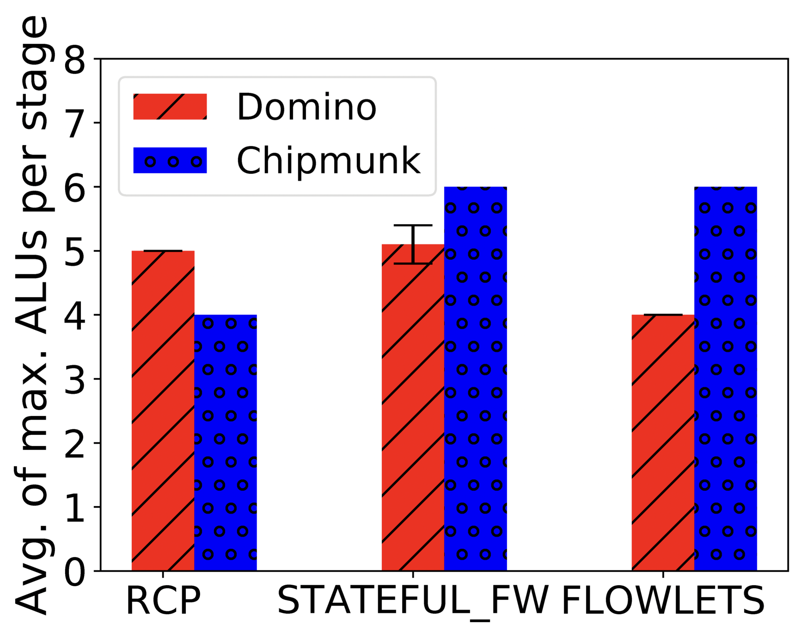
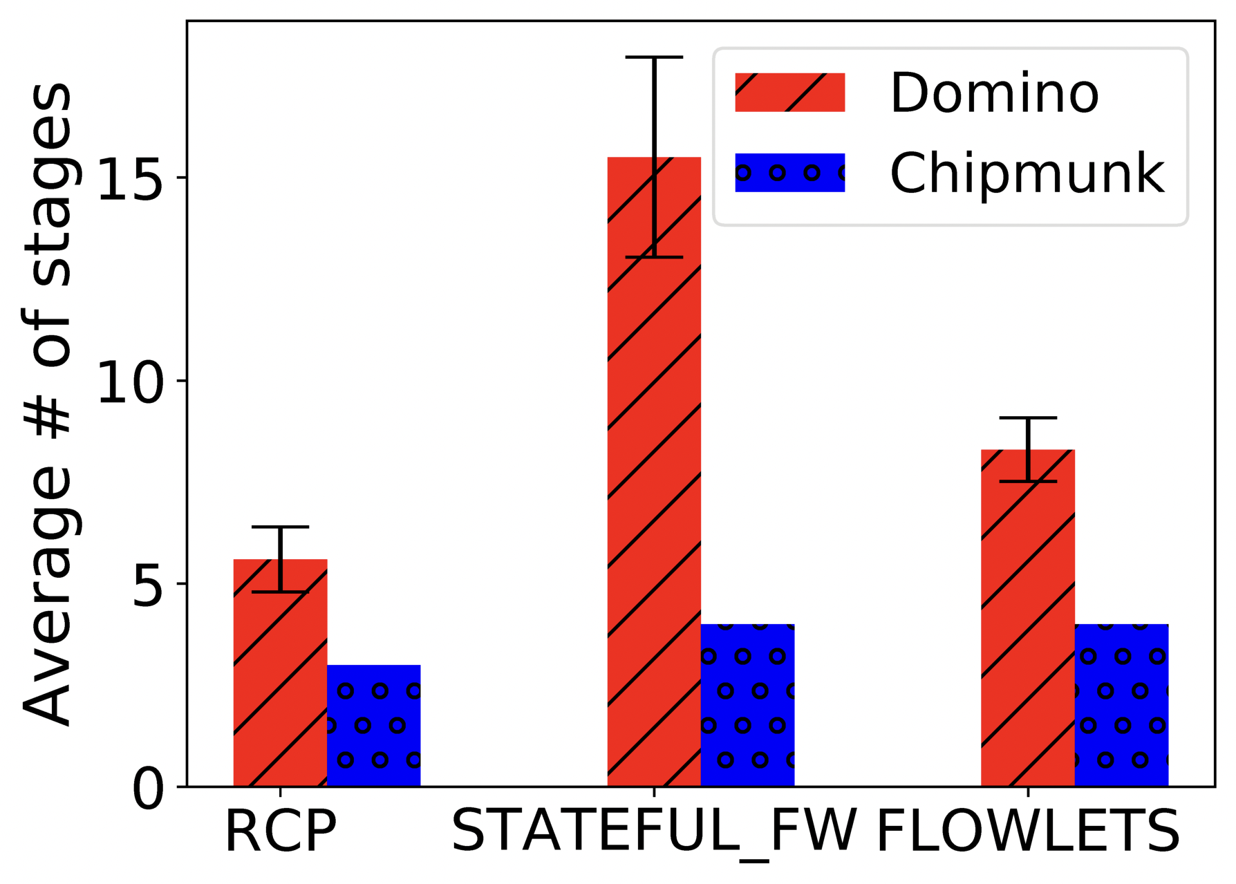
Evaluation: resource consumption
Notes:
For mutations on which both Domino and Chipmunk are successful, Chipmunk can generate code with fewer pipeline stages which is quite constrained in programmable switches (e.g., 12 stages for Tofino switch). Chipmunk sometimes consumes more ALUs per stage than Domino, but given that there are several hundred ALUs available per stage, this is not a problem.
TODO: Redo the figure in ppt.

Slide 19
Conclusion
Program synthesis can play an important role in code generation for fast packet processing
Program synthesis can do for fast packet processing what SAT/SMT have done for network verification.
Future work: code generation for other programmable substrates (e.g., SmartNICs, FPGAs, DPDK, etc.)
Notes:
#### To conclude, Chipmunk transplants program synthesis ideas to networking to automatically generate fast packet-processing code.
%We have shown that program-synthesis-based code generation leads to higher quality of generated code relative to handcrafted compiler rules. We also believe that it might be easier to engineer code generators for emerging devices using program synthesis rather than handcrafted rules.%
#### More generally, we think program synthesis can help enable fast packet processing in the same way that SAT and SMT solvers have helped enable network verification over the last decade.
#### As part of future work, #### we plan to explore code generation for other programmable substrates such as SmartNICs, FPGAs, the DPDK framework.
%% We are also looking at opportunities to speed up the core program synthesis routines used in our code generator.
Thank you for listening and I would be happy to take any questions.

Slide 20
Backup slides

Slide 21
Using program synthesis for code generation
Compiler
Programmer
Compiler developer
©
Partial program representing
programmable hardware’s
capabilities
Programmer’s program
(SKETCH specification)
SKETCH program
Synthesis engine
Completed program output
by SKETCH
Low-level machine code
Notes:
Now, how do we use SKETCH for code generation?
Let’s consider a scenario, where we have a programmer who writes the packet-processing program and a compiler developer who is responsible for developing the compiler. Then, the programmer’s packet-processing program becomes the specification for SKETCH. The compiler developer writes a partial program that represents the search space of legal machine code implementations for any packet-processing program. In particular, the compiler developer uses holes to represent any degree of freedom that the programmable hardware provides.
Then, this partial program and the specification are fed into the the SKETCH program synthesis engine, which forms the core of the compiler. The compiler then outputs whether the program could be completed by SKETCH or not---or whether it is infeasible. If the partial program can actually be completed by SKETCH, we can use the completed program to derive low-level machine code.

Slide 22
Evaluation: how do Domino and Chipmunk compare on the mutations?
Domino compilation time: Very quick; few seconds on most benchmarks
Program | Chipmunk | Domino | Chipmunk Compilation time (sec)
RCP | 10/10 | 10/10 | 69.4 +/- 1.96 * 41
Sampling | 10/10 | 0/10 | 29 +/- 1.96 * 6.7
BLUE (increase) | 10/10 | 0/10 | 445 +/- 1.96 * 306
BLUE (decrease) | 8/10 | 0/10 | 12251 +/- 1.96 * 16357
Flowlet switching | 10/10 | 10/10 | 15269 +/- 1.96 * 17463
Detecting new flows | 10/10 | 0/10 | 8.8 +/- 1/96 * 0.37
Detecting flow reordering | 10/10 | 0/10 | 15.5 +/- 1.96 * 0.3
Notes:
Our experiment results have shown the advantages of our Chipmunk mainly in two aspects.
Domino fails to generate code for most mutations of the original programs because it incorrectly concludes that the programs are too expressive to be implemented, which is avoided in Chipmunk because it reaches 100% for most of them which should be expected. Some programs which is rejected by Chipmunk are all because they reach the timeout we set for them (30 min per iteration). Here the average of compilation time for each mutations in Flowlet switching is about an hour.
If we provide enough time, they will finally provide the successful compilation result.
Note: add the graph to show why theoretically, Chipmunk should work for every mutator
Note: Make the table and font size larger

Slide 23
Evaluation: summary
In general, Chipmunk can compile many mutation that Domino cannot
Chipmunk consumes smaller number of stages and ALUs
However, the compilation time of Chipmunk is much longer than Domino.
Notes:
In general, Chipmunk can compile many mutation that Domino cannot
Chipmunk will find the optimal resources usage, with smaller depth and width
However, due to the complexity of program synthesis problem, the compilation time of Chipmunk is much longer than Domino
Emphasize the conclusion again and reiterate the benefit of Chipmunk and show why its result will be much better.
We are currently working on heuristics to speed up Chipmunk’s compilaton time.

Slide 24
Hardware configurations as SKETCH holes
Input
Mux
PHV
Container
Stateless ALU
PHV
Container
Stateless ALU
PHV
Container
PHV
Container
Stateless ALU
PHV
Container
Stateless ALU
PHV
Container
Stateful ALU
Stateful ALU
PHV
Output
Mux
PHV
PHV
State storage
State storage
Stateful ALU
Stateful ALU
State storage
State storage
Output Mux
Stateless opcode
Immediate value
Input Mux
Constant value
Stateful active
Notes:
We have so many holes even within a very simple example. We have input Mux to control which value should be fed to one particular stage; we have output mux to determine the value passed to the next stage; we have constant value and immediate value to decide the constants used in stateless and stateful ALU; we have stateful active to monitor which stateful ALU is responsible for modifying the stateful value and we also have stateless opcode to represent the functionality of stateless ALU

Slide 25
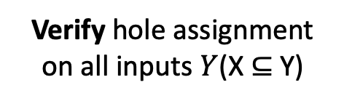
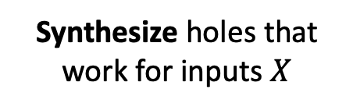
Tutorial on SKETCH’s synthesis algorithm
Counterexample Guided Inductive Synthesis
Hole Assignment
Initialize X to random inputs
Synthesize holes that work for inputs $X$
Verify hole assignment on all inputs $Y$(X ⊆ Y)
No Hole Assignment
Add c to X
No Counterexamples
Counterexample Input c
Failure
Success
Notes:
Now, I’ll describe how SKETCH actually performs synthesis given the specification and the partial program. SKETCH uses an algorithm called counterexample-guided inductive synthesis (or CEGIS).
The program synthesis problem solves for hole values in the formula in first-order logic which is a QBF (quantified Boolean formula) problem which is harder than SAT problem. Therefore, CEGIS divides the whole program synthesis problem into two phases: synthesis phase and verification phase.
The synthesis phase will use try to solve holes’ value assignments to satisfy the ‘partial’ inputs and the verification phase will verify the hole value assignments on all inputs which is specified by programmers. For example, if we set the input range to be 5 bits. In the beginning, sketch will randoml
y choose subset of all inputs to do the synthesis, if it fails it means there should be no feasible solutions; if it succeeds, it will continue to the verification stage to test more inputs. If we pass the verification, we are lucky enough to find the final solution otherwise, there is at least one input making the current hole assignment fail to work. So we add this counterexample into the input set and repeat synthesis again. Back and forth until we get the final result.
Both synthesis and verification of CEGIS are simpler than directly solve the QBF problem because for each step we either fix test inputs or hole values, turning the QBF problem into a SAT problem which can be fed to a more efficient SAT solver.

Slide 26
Conclusion and future directions
Speed up synthesis time (e.g. use multiple machines)
Synthesize “superoptimized” code for processors
Synthesize fast but approximate packet-processing programs
Notes:
The initial experiment results look promising. however we think this is still a beginning for this project. Throughout the whole process, we also develop many directions worthwhile for further research. Here, I want to list the three most important ones for open discussion.
As for further speeding up, can we reduce the program synthesis time by using multiple machine or to say our own parallel computation method? Can we try synthesize “superoptimized” code for processors? Also, can we synthesize fast but approximate packet-processing programs?
What do we mean by this? Synthesize “superoptimized” code for processors

Slide 27
Evaluation: Mutation types
Switch the if-else statement
Switch the order of statement within if
if (condition_1) {do A;} else {do B;} -----> if(!condition_1) {do B;} else {do A;}
if (condition_1 && condition_2) -----> if (condition_2 && condition_1)
Essentially: create some ”noise” for program so as to increase compilation difficult for traditional Domino compiler

Slide 28
Speeding up synthesis
Our own CEGIS Algorithm
Canonicalized allocation vs synthesized allocation
Gradual search for stateless ALU
Notes:
Chipmunk can beat Domino in almost every aspects at the sacrifice of compilation time. Because the program synthesis problem is a QBF problem
whose total time increases exponentially as the number of holes increase. For example, if there are n holes, then the search space will be as large as 2^n
and most of our benchmarks generate 200 holes.
Therefore, we come up with three main ideas listed above to speed up synthesis problem. I will discuss them one by one.

Slide 29
Reduce the constant values
#define FREEZE_TIME 10
#define DELTA2 2
struct Packet {
int now;
int now_plus_free;
};
int last_update;
int p_mark;
void func(struct Packet p) {
p.now_plus_free = p.now - FREEZE_TIME;
if (p.now_plus_free > last_update) {
p_mark = p_mark - DELTA2;
last_update = p.now;
}
}
#define FREEZE_TIME 2
#define DELTA2 2
struct Packet {
int now;
int now_plus_free;
};
int last_update;
int p_mark;
void func(struct Packet p) {
p.now_plus_free = p.now - FREEZE_TIME;
if (p.now_plus_free > last_update) {
p_mark = p_mark - DELTA2;
last_update = p.now;
}
}
Constrain all constants appear in benchmarks into 2-bit range in order to reduce the search space of program synthesis
Notes:
The first part is to reduce the constant values appearing in benchmarks.
For example, the example shown in the slides is blue_decrease.c in Domino program. We manually scan the program and downgrade all constants
appearing in program into constants within 2-bit range. Here, we replace 10 by 2.
The benefit of this transformation is that all constant/immediate holes appear in Chipmunk will only be 2-bit range which can dramatically reduce the
total number of holes. Although we slightly change the semantics of some of benchmarks, but for these case, we only focus on the compilation result
so this change is reasonable.
In future work, we will try to add constant synthesis algorithm to avoid semantic modification.

Slide 30
Our own CEGIS Algorithm
Completes spec with 2 bit inputs
Sketch Compiler
Input Spec file
Add c to X
Completed Sketch File
Verification on 10 bits
Z3 solver
Input Sketch file
Failure – Counter Example c Found
Successful Verification
Constrain the input into 2-bit range for synthesis
Do verification in 10-bit range
Add the counterexample into input if the verification fails
Verified Sketch File
Notes:
The first part is to use our own CEGIS algorithm.
Previously, we introduce the CEGIS algorithm implemented in SKETCH. We referred from that idea to develop our own version of CEGIS.
Instead of throwing the whole synthesis problem with 10-bit input into sketch, we divide into two parts: synthesis & verification in 2-bit input; -> do verification in 10-bit input range -> if the verification failed then we add the counterexample into synthesis part so the synthesis step will have all 2-bit input + counterexample we generated from all previous verification steps; otherwise we are lucky enough to find a sol in smaller input range which satisfies for all 10-bit input.

Slide 31
Programming network devices today
Lots of programmable network devices (e.g., …) TODO: Add pictures.
Easy to get started with programming these devices, but hard to write optimized code.
Notes:
And the main reason why people want to use programmable substrates to gradually replace the traditional fixed ones is that the former enjoy the function flexibility which is not shared by the later one. To be specific, in the background where various AI and IoT applications appear so quickly that people have more requirements for low-level network. However, traditional fixed network substrates have fixed functionality and users cannot fundamentally change it. If the designers want to include more functions into programmable substrates, it may take several years. In addition to programmability, with the growing link speeds, there is a need to speed up the running speed in programmable substrates by using faster packet-processing code. For example, SmartNICs run at line rates of 40-100 Gbit/s. Switches run at 100Gbit/s per port, a few Tbit/s in aggregate.
So with this emphasis on using programmable substrates and writing fast packet-processing code in them, developing fast programs is really difficult.

Slide 32
Canonicalized allocation vs synthesized allocation
Field 1
Container 1
Field 1
Container 1
Field 2
Container 2
Field 2
Container 2
Field 3
Container 3
Field 3
Container 3
Field 4
Container 4
Field 4
Container 4
Indicator-variable allocation
Canonical allocation
Synthesized-allocation and Canonicalized-allocation are “syntatically” different
Synthesized-allocation and Canonicalized-allocation are “semantically” equivalent
Canonicalized-allocation has smaller search space for program synthesis problem
Notes:
In addition to our “own” CEGIS algorithm,
we want to add more constrain which not only conserves the function of Chipmunk but also
reduce the search space.
In allocation case, we found that all possible position on the LHS can be mapped to one particular
way in the RHS, so there must be some benefit if we choose to remove the freedom by forcing
packet field to specific container.

Slide 33
Gradual search for stateless ALU
Arithmetic
(i.e. +/-)
Relation
(i.e. !=, >, <)
Condition
(i.e. if-else)
Boolean
(i.e. ||, &&)
Rank the operation appearing in program by frequency
Choose simpler stateless ALU for program synthesis
Notes:
For some benchmarks, there are only some of the simple operation in packet fields, so we can
choose simpler stateless ALU so that the total hole numbers can get slightly decreased. But there
are still some disadvantages if we use simplified version of stateless ALU because it may convert
from success to failure.
If permitted, we can make full use of the distributed system to run different stateless ALUs
In different machine and use optimal result. (fail from full stateless ALU or success from simplified stateless ALU)

Slide 34
Stateful ALU and Stateless ALU
include "muxes.sk";
include "rel_ops.sk";
include "constants.sk";
StateResult atom_template(int state_1, int state_2, int pkt_1, int pkt_2, int pkt_3, int pkt_4, int pkt_5) {
if (rel_op(Opt(state_1), Mux3(pkt_1, pkt_2, C()))) {
state_1 = Opt(state_1) + Mux3(pkt_1, pkt_2, C());
}
StateResult ret = new StateResult();
ret.result_state_1 = state_1;
ret.result_state_2 = state_2;
return ret;
}
state_0
pkt_0, pkt_1
if (rel_op(Opt(state_0), Mux3(pkt_0, pkt_1, C()))) {
state_0 = Opt(state_0) + Mux3(pkt_0, pkt_1, C());
}

Slide 35
Stateful ALU and Stateless ALU
// Max value of opcode is 5
int {{ alu_name }}({{arg_list|join(',')}}, int opcode_hole_local, int immediate_operand_hole_local, int mux1_ctrl_hole_local, int mux2_ctrl_hole_local, int mux3_ctrl_hole_local) {
int opcode = opcode_hole_local;
int immediate_operand = immediate_operand_hole_local;
int x = {{ mux1 }}({{potential_operands|join(',')}}, mux1_ctrl_hole_local);
int y = {{ mux2 }}({{potential_operands|join(',')}}, mux2_ctrl_hole_local);
int z = {{ mux3 }}({{potential_operands|join(',')}}, mux3_ctrl_hole_local);
if (opcode == 0) {
return immediate_operand;
} else if (opcode == 1) {
return x + y;
} else if (opcode == 2) {
return x + immediate_operand;
} else if (opcode == 3) {
return x - y;
} else if (opcode == 4) {
return x - immediate_operand;
} else {
return immediate_operand - x;
}
}
Manually create the stateless ALU to support arith operator,

Slide 36
TODO
Notes:
Be consistent between network devices, network substrates, packet-processing devices, etc.
Fast program vs. fast packet processing programs.
Alignment of arrows
Consistency of fonts across all slides

